Slide 1
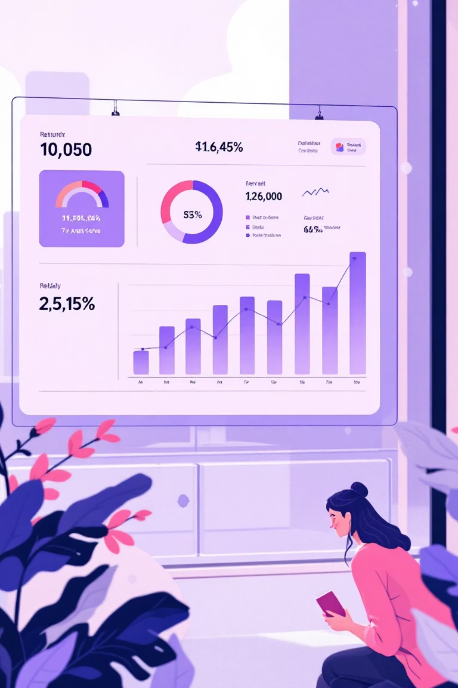

Consumer Shopping Behavior Analysis
Examining 3,900 purchases to uncover spending trends, customer segments, and subscription patterns
PYTHON
POSTGRESQL
POWER BI
EXCEL

Slide 2
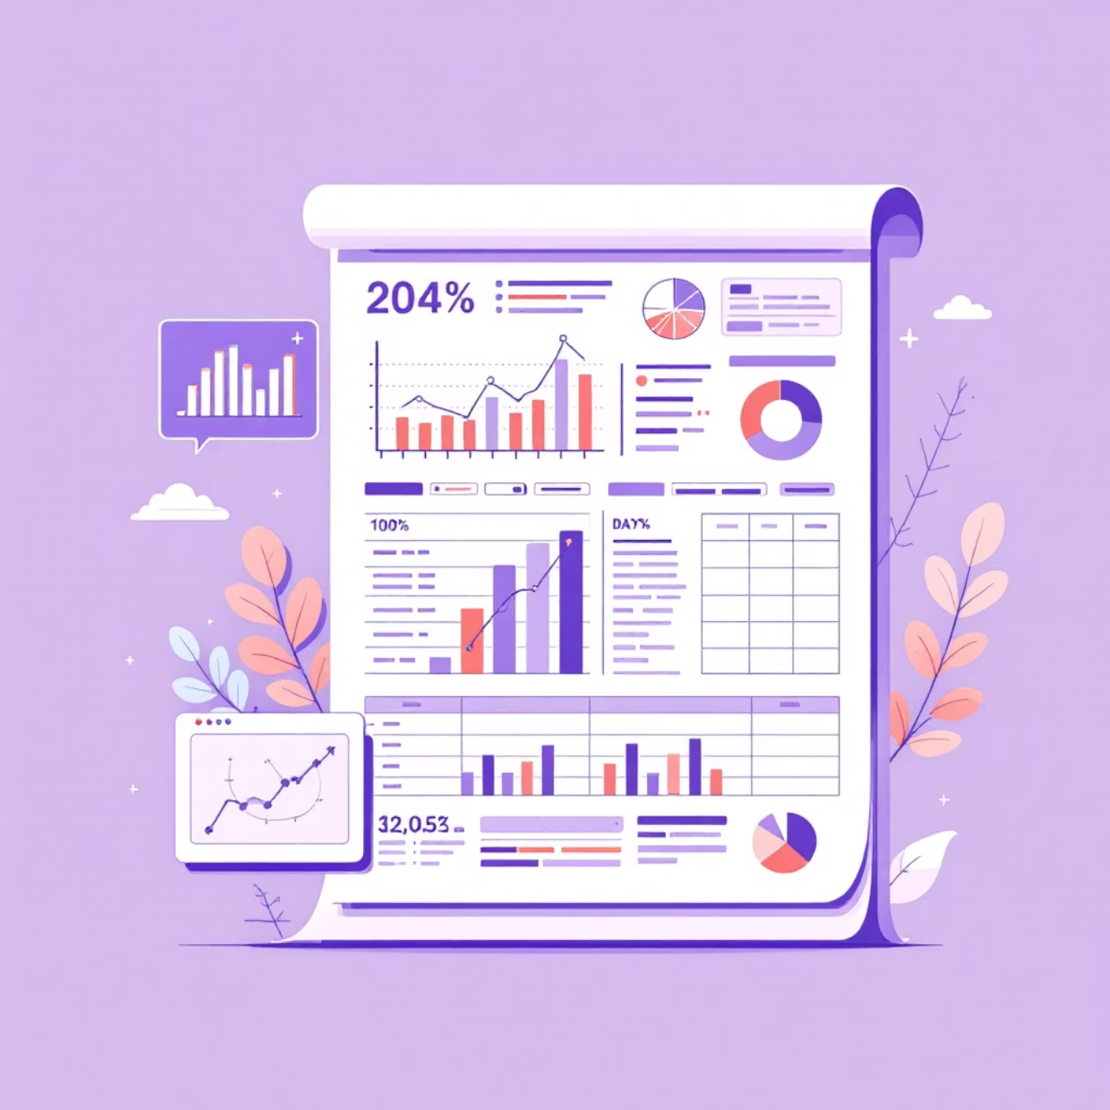
DATASET OVERVIEW
The Foundation
3,900
18
Total Purchases
Data Points
Transaction records analyzed
Features per transaction
37
Missing Values
Review ratings imputed
Key Features Captured
Customer demographics: Age, Gender, Location, Subscription Status
Purchase details: Item, Category, Amount, Season, Size, Color
Shopping behavior: Discounts, Previous Purchases, Review Rating, Shipping Type

Slide 3

DATA PREPARATION
Python-Powered Data Cleaning
01
Data Loading & Exploration
Imported dataset using pandas, analyzed structure with df.info() and summary statistics
02
Missing Data Handling
Imputed Review Rating nulls using median rating per product category
03
Feature Engineering
Created age_group bins and purchase_frequency_days columns
04
Standardization & Integration
Renamed columns to snake_case, removed redundant fields, loaded to PostgreSQL

Slide 4


SQL ANALYSIS
Revenue Insights by Gender
Gender Revenue Comparison
Analyzed total revenue generated by male vs. female customers to identify spending patterns and opportunities for targeted marketing strategies.
Key Finding: Understanding gender-based purchasing behavior enables more effective campaign personalization and product positioning.

Slide 5

High-Value Discount Users
Smart Spenders Identified
Strategic Opportunity
Marketing Potential
These buyers represent high-value customers who respond to promotions without sacrificing basket size
Target this segment with exclusive offers to drive loyalty and repeat purchases
Customers who used discounts but still spent above average purchase amount

Slide 6

TOP PERFORMERS
Product Excellence
Top 5 Products by Rating
Identified highest-rated products based on customer reviews
Shipping Preferences
Compared average purchase amounts between Standard and Express shipping methods
Quality Signals
Shipping Insights
Top-rated products drive customer satisfaction and repeat business
Express shipping users show distinct spending patterns worth targeting

Slide 7



Subscription Impact Analysis
2.3x
68%
5+
Higher Average Spend
Revenue Contribution
Purchase Threshold
Subscribers vs. non-subscribers
From subscription customers
Repeat buyers likely to subscribe
Customers with more than 5 purchases show significantly higher subscription conversion rates, indicating strong loyalty potential.

Slide 8



CUSTOMER SEGMENTATION
Understanding Customer Lifecycle
Loyal
1
10+ purchases
Returning
2
2-9 purchases
New
3
1 purchase
Discount-Dependent Products
Category Leaders
Age Group Revenue
5 products with highest % of discounted purchases identified
Top 3 most purchased products per category analyzed
Total contribution calculated by demographic segment

Slide 9

VISUALIZATION
Interactive Power BI Dashboard
Revenue Trends
Track spending patterns across time, categories, and customer segments
Customer Insights
Visualize demographics, subscription status, and purchase frequency
Interactive Filters
Drill down by age group, location, product category, and shipping type

Slide 10





RECOMMENDATIONS
Strategic Action Plan
Boost Subscriptions
Promote exclusive benefits and perks for subscribers to increase conversion
Loyalty Programs
Reward repeat buyers to move them into "Loyal" segment faster
Review Discount Policy
Balance sales boosts with margin control for sustainable growth
Product Positioning
Highlight top-rated and best-selling products in marketing campaigns
Targeted Marketing
Focus on high-revenue age groups and express-shipping users

